Slide 1
Game Box Business Plan

Slide 2
CONTENTS
1
Creativity and innovation of the app design
2
Level of detail in the market analysis
3
Feasibility of the marketing plan

Slide 3
PART ONE
Creativity and innovation of the app design

Slide 4
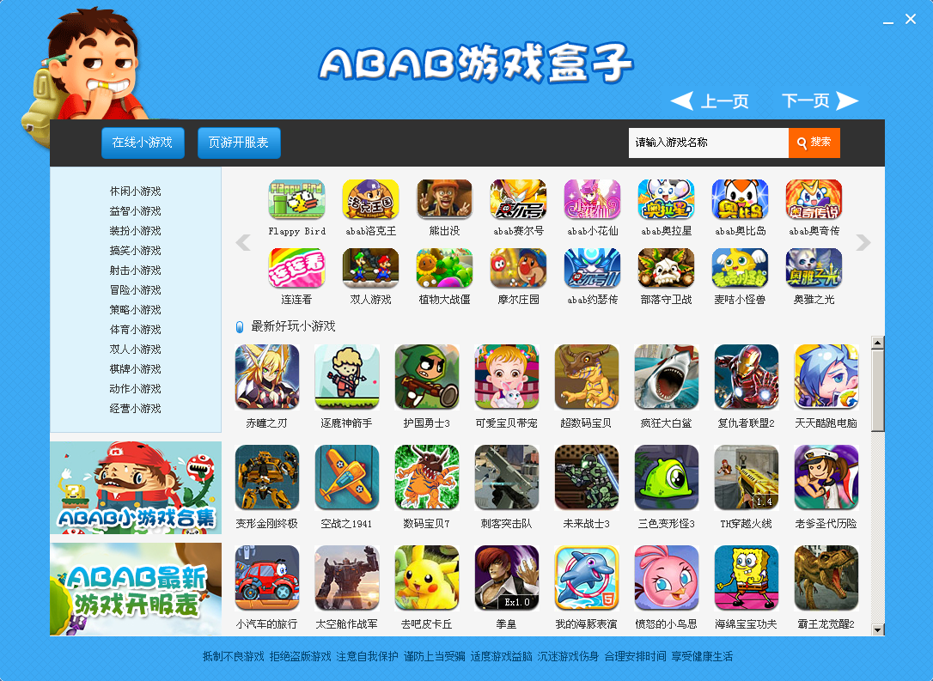
The Creative and Innovative Game Box for Application Design is an innovative game management application designed to provide users with appropriate game recommendations based on their age group and area. Our application not only makes it easier for users to browse and select games, but also provides advanced features such as game search, game scoring, and game sharing. We also suggest that users can comment on the game to help other users better understand the content of the game

Slide 5
PART two
Level of detail in the market analysis

Slide 6
Market analysis level of detail Our target market is game players worldwide, with many different age groups of users, so our game box application can recommend appropriate games to users based on their age groups. In addition, we will also provide different games for users in different regions to meet their needs.

Slide 7

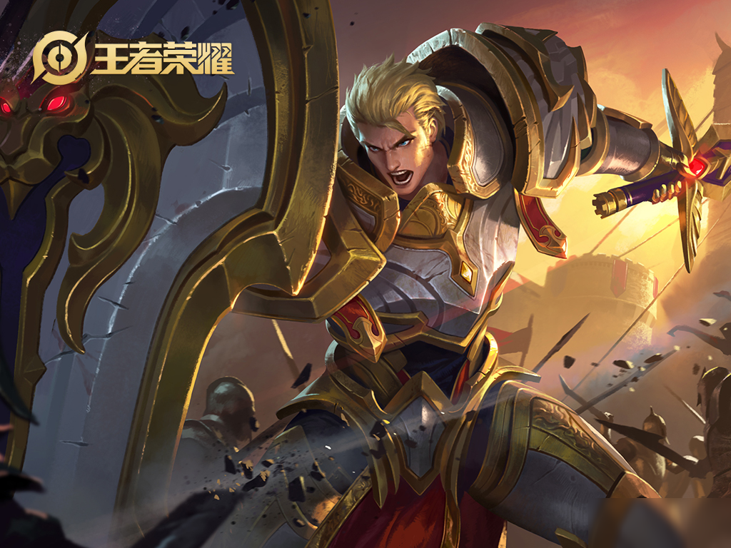
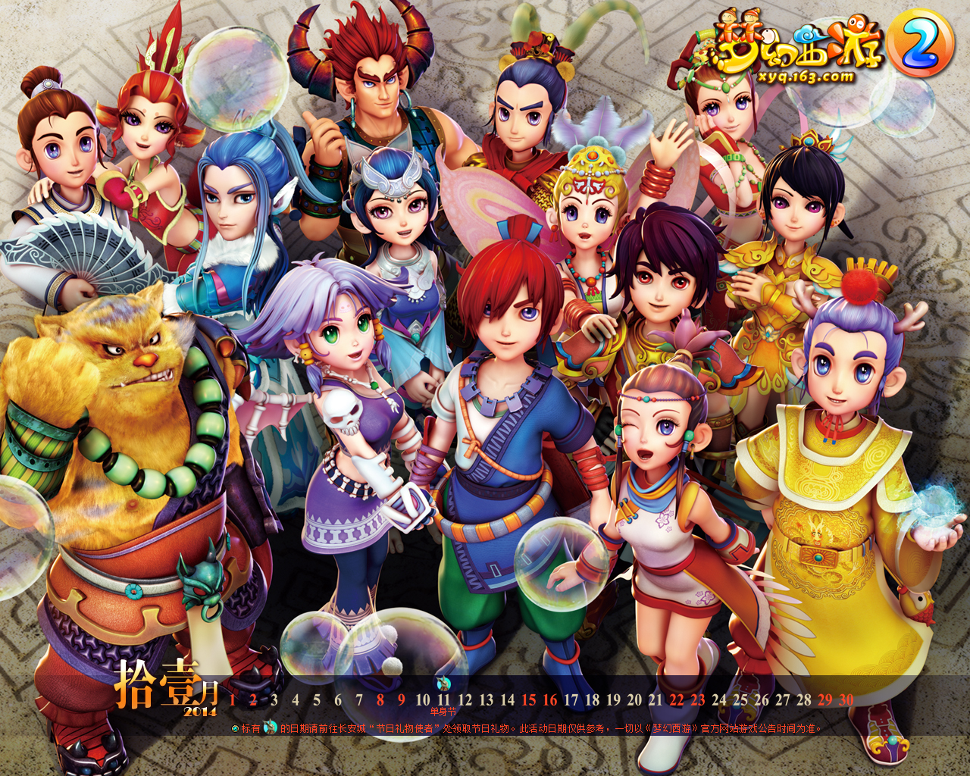
Main Games by Age Group
80后
90后
00后

Slide 8
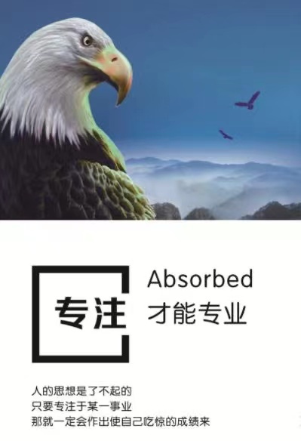
Why do users download games through game boxes？

Slide 9
PART Three
Feasibility of the marketing plan

Slide 10

Feasibility of marketing plan We will adopt various marketing activities to promote game box applications, including social media promotion, online game portal promotion, online advertising, etc. We will also use the help of some third-party game developers to promote our applications.

Slide 11
演讲完毕感谢观看

